Slide 1

SAP BTP ABAP on Cloud / RAP Training
DAY-14
Anubhav Oberoy
www.AnubhavTrainings.com
Follow excellence with sheer passion

Slide 2


DISCLAIMER
The training content and delivery of this presentation is confidential, and cannot be recorded, or copied and distributed to any third party, without the written consent of Anubhav Trainings

Slide 3

01
Analytic Use case
02
Develop data model
03
Create ALP
04
Create OVP
Notes:
https://pixabay.com/photos/san-francisco-transamerica-pyramid-1633203/

Slide 4
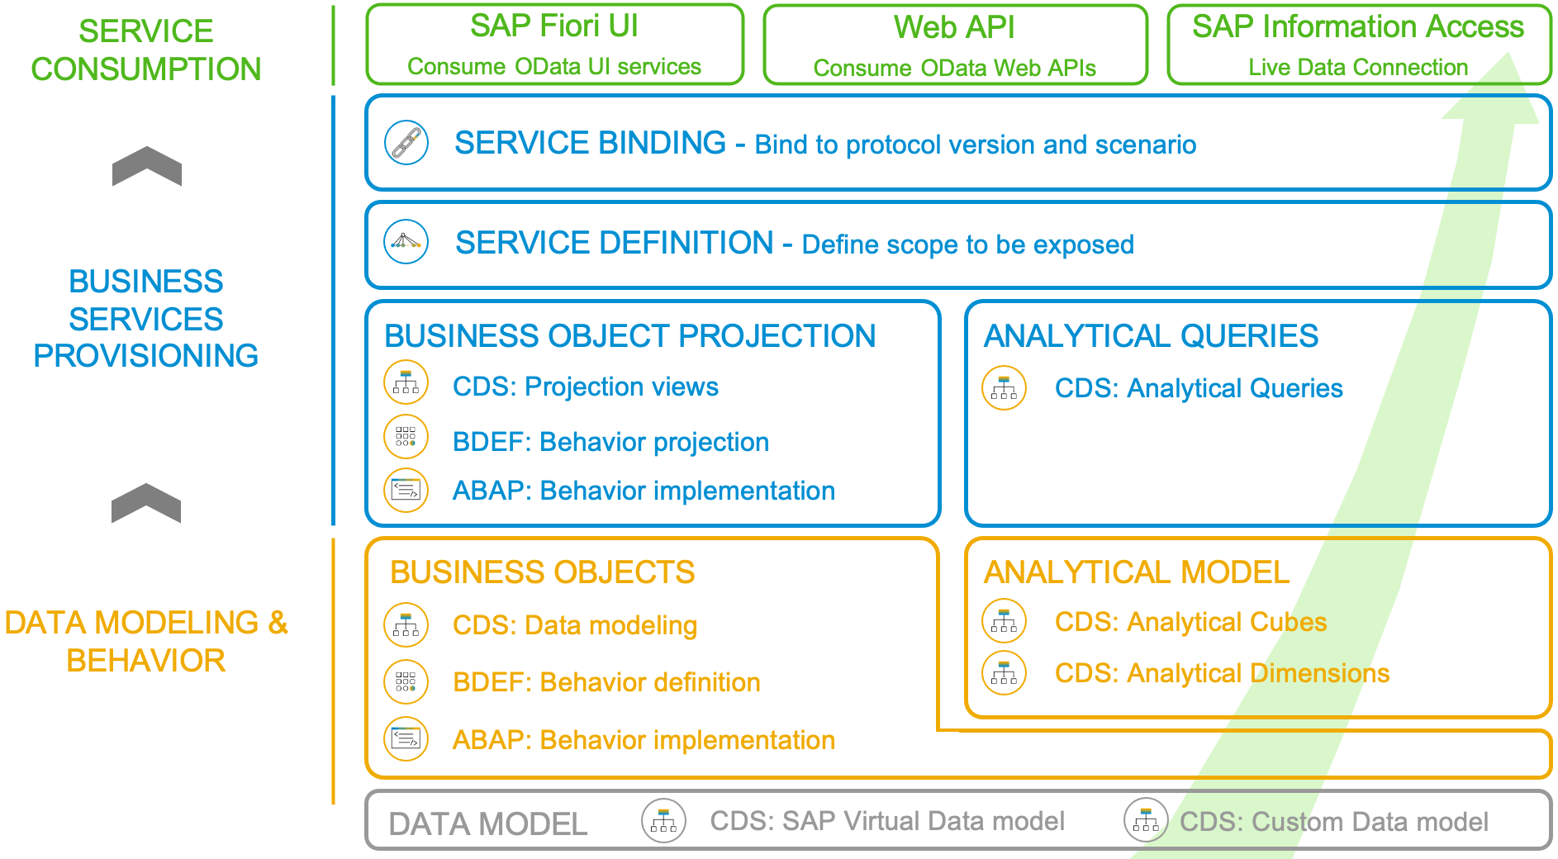
Development Flow of Scenario
With the 2102 release, the SAP BTP ABAP Environment opened up the door for analytics developments. The programming model follows the same “RAP” paradigm as in the transactional world: The entity model is implemented with CDS views that make use of additional analytical annotations that were now also released for the usage in the BTP ABAP Environment ("Steampunk”). As there is no access to the analytical backend transactions nor to the analytical key user tools, an analytical preview was also introduced, so that a developer can test his developments directly in the ABAP Development Tools. Another novelty is the introduction of an analytical service exposure. For an analytical service to be used as real time connection with a supported client (like e.g., SAP Analytics Cloud), the SAP Information Access protocol (InA) is required whereas transactional services rely on the OData protocol.
www.anubhavtrainings.com

Slide 5
ALP Analytic List Page
An Analytical List Page (ALP) is a SAP Fiori element that allows users to analyze data and take action on it. It's a key component of SAP Fiori embedded analytics.
Here are some things you can do with an ALP:
Analyze data: Use KPIs, charts, tables, and visual filters to analyze data from different perspectives
Investigate root causes: Drill down to find root causes
Act on transactional content: Take action on transactional content
Build apps: Create apps that visualize and report data
Combine data: Combine transactional and analytical data using charts and tables
ALPs have a flexible layout that can be customized in a number of ways, including:
Sorting: Sort the work list
Page layout: Set page layout preferences
Filters: Set filters and save filter selections
Default views: Set default views
ALPs are organized into two sections: a header section for setting filters, and a content section for displaying charts and lists.
www.anubhavtrainings.com

Slide 6
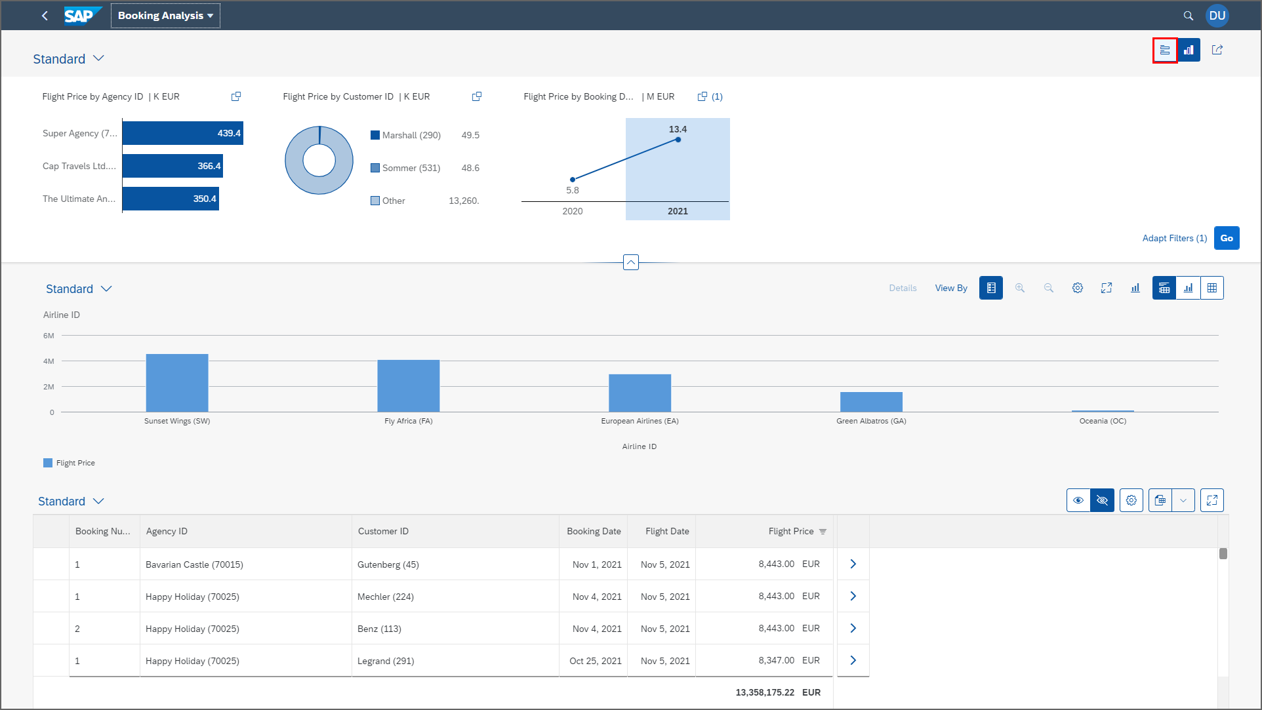
ALP
www.anubhavtrainings.com

Slide 7
Booking Consumption Analytics View
Booking Analytics CDS entity
Travel Analytics CDS entity
Carrier
Connection
/dmo/travel
/dmo/customer
/dmo/agency
Bookings

Slide 8
OVP – Overview pages
The Overview Page (OVP) in SAP is a data-driven app that provides users with a single page of information based on their role or domain. It helps users focus on important tasks by allowing them to quickly view, filter, and react to information.
Here are some things to know about the OVP:
Structure
The OVP has a header area and a content area. The content area displays cards that can contain charts, lists, tables, or text.
Cards
The OVP supports both standard and custom cards. Standard cards are entry-level views of the most relevant app data for a given topic or issue. Custom cards allow you to define the appearance and content of a card.
List cards
The OVP supports three types of list cards: list card, bar chart list card, and link list card.
Flavors
List cards can have two types of flavors: standard and bar. Standard flavor cards display items as numbers and text, while bar flavor cards display items as a combination of numbers, text, and a bar.
www.anubhavtrainings.com

Slide 9
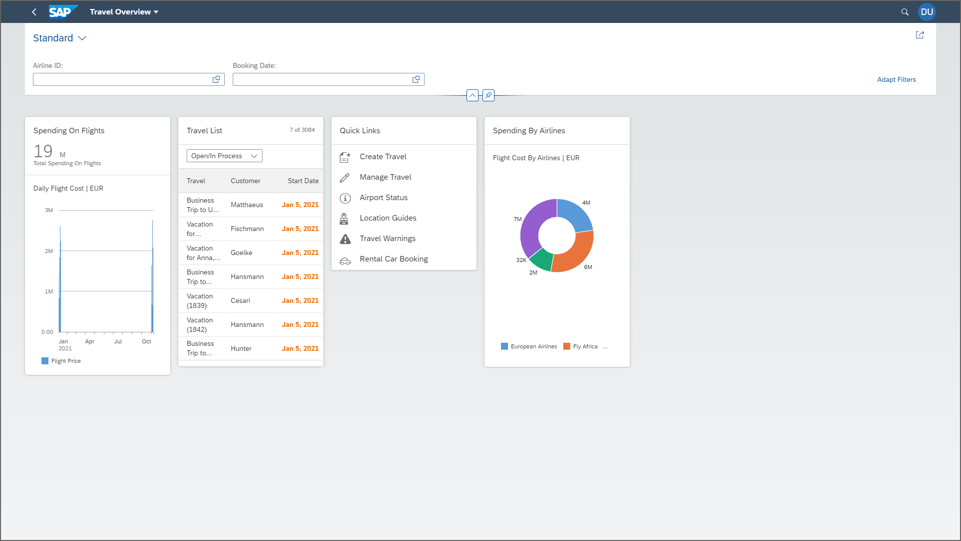
OVP
www.anubhavtrainings.com

Slide 10
www.anubhavtrainings.com
Thank You
End of Day 14
www.anubhavtrainings.com

Slide 11


We’re committed to empower you to be
#FutureReady
through powerful training solutions.
We build the workforce of the future.
250+
Corporate Clients
30,000+
Learners Trained
25000+
Learners Placed
FREE WEBINARS
Sign up for free webinars with industry experts every fortnight!
Enroll Now!
Contact us today!
https://anubhavtrainings.com

